Slide 1
Restriction Mapping
Example Problems

Slide 2
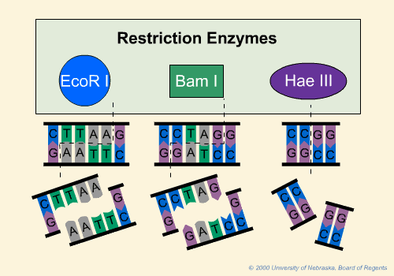
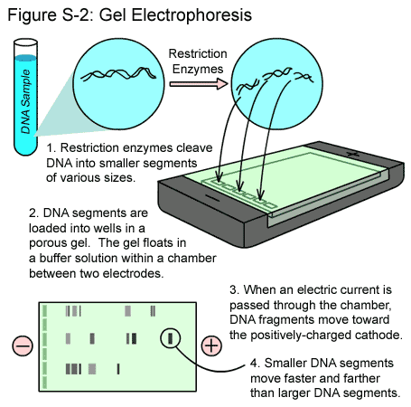
RFLP Analysis
Restriction Fragment Length Polymorphisms
Restriction enzymes from bacteria cut DNA molecules to create DNA fragments of varying lengths
Separate fragments in gel electrophoresis
DNA fingerprinting (CSI, paternity)
Notes:
Bacterial restrict
Most of our DNA is identical to DNA of others. However, there are inherited regions of our DNA that can vary from person to person. Variations in DNA sequence between individuals are termed "polymorphisms".
- difference in homologous DNA sequences that can be detected by the presence of fragments of different lengths after digestion of the DNA samples in question with specific restriction endonucleases.
- degree of polymorphism are very useful for DNA analysis in forensics cases and paternity testing.
DNA regions with short repeat units (usually 2-6 bp in length) are called Short Tandem Repeats (STR).
STRs are found surrounding the chromosomal centromere (the structural center of the chromosomes). STRs have proven to have several benefits that make them especially suitable for human identification.
An individual inherits one copy of an STR from each parent, which may or may not have similar repeat sizes. The number of repeats in STR markers can be highly variable among individuals, which make these STRs effective for human identification purposes.

Slide 3
Example #1: Linear DNA
DNA Sample | Fragment Lengths (bp)
Uncut DNA | 10,000
DNA cut with EcoRI | 8,000 2,000
DNA cut with BamHI | 5,000 5,000
DNA cut with EcoRI + BamHI | 5,000 3,000 2,000

Slide 4
Example #1: Linear DNA
DNA Sample | Fragment Lengths (bp)
Uncut DNA | 10,000
DNA cut with EcoRI | 8,000 2,000
DNA cut with BamHI | 5,000 5,000
DNA cut with EcoRI + BamHI | 5,000 3,000 2,000
Uncut
10,000 bp

Slide 5
Example #1: Linear DNA
DNA Sample | Fragment Lengths (bp)
Uncut DNA | 10,000
DNA cut with EcoRI | 8,000 2,000
DNA cut with BamHI | 5,000 5,000
DNA cut with EcoRI + BamHI | 5,000 3,000 2,000
Uncut
10,000 bp
EcoRI
8,000 bp
2,000 bp

Slide 6
Example #1: Linear DNA
DNA Sample | Fragment Lengths (bp)
Uncut DNA | 10,000
DNA cut with EcoRI | 8,000 2,000
DNA cut with BamHI | 5,000 5,000
DNA cut with EcoRI + BamHI | 5,000 3,000 2,000
Uncut
10,000 bp
EcoRI
8,000 bp
2,000 bp
BamHI
5,000 bp
5,000 bp

Slide 7
Example #1: Linear DNA
DNA Sample | Fragment Lengths (bp)
Uncut DNA | 10,000
DNA cut with EcoRI | 8,000 2,000
DNA cut with BamHI | 5,000 5,000
DNA cut with EcoRI + BamHI | 5,000 3,000 2,000
Uncut
10,000 bp
EcoRI
8,000 bp
2,000 bp
BamHI
5,000 bp
5,000 bp
E + B
5,000 bp
3,000 bp
2,000 bp
B
E

Slide 8
Example #2: Plasmid (circular) DNA
DNA Sample | Fragment Length (bp)
Uncut DNA | 17,000
DNA cut with SmaI | 17,000
DNA cut with HaeIII | 17,000
DNA cut with PstI | 10,000 7,000
DNA cut with SmaI + HaeIII | 12,000 5,000
DNA cut with SmaI + PstI | 10,000 6,000 1,000
DNA cut with HaeIII + PstI | 7,000 6,000 4,000

Slide 9
Example #2: Plasmid (circular) DNA
DNA Sample | Fragment Length (bp)
Uncut DNA | 17,000
DNA cut with SmaI | 17,000
DNA cut with HaeIII | 17,000
DNA cut with PstI | 10,000 7,000
DNA cut with SmaI + HaeIII | 12,000 5,000
DNA cut with SmaI + PstI | 10,000 6,000 1,000
DNA cut with HaeIII + PstI | 7,000 6,000 4,000
Uncut
17,000

Slide 10
Example #2: Plasmid (circular) DNA
DNA Sample | Fragment Length (bp)
Uncut DNA | 17,000
DNA cut with SmaI | 17,000
DNA cut with HaeIII | 17,000
DNA cut with PstI | 10,000 7,000
DNA cut with SmaI + HaeIII | 12,000 5,000
DNA cut with SmaI + PstI | 10,000 6,000 1,000
DNA cut with HaeIII + PstI | 7,000 6,000 4,000
Uncut
17,000
SmaI
17,000
S
Notes:
Different than linear because 1 cut results in 1 fragment versus linear when 1 cut makes 2 fragments

Slide 11
Example #2: Plasmid (circular) DNA
DNA Sample | Fragment Length (bp)
Uncut DNA | 17,000
DNA cut with SmaI | 17,000
DNA cut with HaeIII | 17,000
DNA cut with PstI | 10,000 7,000
DNA cut with SmaI + HaeIII | 12,000 5,000
DNA cut with SmaI + PstI | 10,000 6,000 1,000
DNA cut with HaeIII + PstI | 7,000 6,000 4,000
Uncut
17,000
SmaI
H
HaeIII
17,000
17,000
S

Slide 12
Example #2: Plasmid (circular) DNA
DNA Sample | Fragment Length (bp)
Uncut DNA | 17,000
DNA cut with SmaI | 17,000
DNA cut with HaeIII | 17,000
DNA cut with PstI | 10,000 7,000
DNA cut with SmaI + HaeIII | 12,000 5,000
DNA cut with SmaI + PstI | 10,000 6,000 1,000
DNA cut with HaeIII + PstI | 7,000 6,000 4,000
Uncut
17,000
SmaI
H
HaeIII
17,000
17,000
S
P
PstI
7,000
10,000
P

Slide 13
Example #2: Plasmid (circular) DNA
DNA Sample | Fragment Length (bp)
Uncut DNA | 17,000
DNA cut with SmaI | 17,000
DNA cut with HaeIII | 17,000
DNA cut with PstI | 10,000 7,000
DNA cut with SmaI + HaeIII | 12,000 5,000
DNA cut with SmaI + PstI | 10,000 6,000 1,000
DNA cut with HaeIII + PstI | 7,000 6,000 4,000
Uncut
17,000
SmaI
H
HaeIII
17,000
17,000
S
P
PstI
7,000
10,000
H
P
S + H
5,000
12,000
S

Slide 14
Example #2: Plasmid (circular) DNA
DNA Sample | Fragment Length (bp)
Uncut DNA | 17,000
DNA cut with SmaI | 17,000
DNA cut with HaeIII | 17,000
DNA cut with PstI | 10,000 7,000
DNA cut with SmaI + HaeIII | 12,000 5,000
DNA cut with SmaI + PstI | 10,000 6,000 1,000
DNA cut with HaeIII + PstI | 7,000 6,000 4,000
Uncut
17,000
SmaI
H
HaeIII
17,000
17,000
S
P
PstI
7,000
S + H
H
10,000
5,000
P
12,000
S
1,000
P
S
S + P
6,000
10,000
P

Slide 15
Example #2: Plasmid (circular) DNA
DNA Sample | Fragment Length (bp)
Uncut DNA | 17,000
DNA cut with SmaI | 17,000
DNA cut with HaeIII | 17,000
DNA cut with PstI | 10,000 7,000
DNA cut with SmaI + HaeIII | 12,000 5,000
DNA cut with SmaI + PstI | 10,000 6,000 1,000
DNA cut with HaeIII + PstI | 7,000 6,000 4,000
Uncut
17,000
SmaI
H
HaeIII
17,000
17,000
S
P
PstI
7,000
S + H
S
H + P
P
10,000
5,000
4,000
P
7,000
12,000
H
H
1,000
P
P
6,000
S
S + P
6,000
10,000
P

Slide 16
Example #2: Plasmid (circular) DNA
DNA Sample | Fragment Length (bp)
Uncut DNA | 17,000
DNA cut with SmaI | 17,000
DNA cut with HaeIII | 17,000
DNA cut with PstI | 10,000 7,000
DNA cut with SmaI + HaeIII | 12,000 5,000
DNA cut with SmaI + PstI | 10,000 6,000 1,000
DNA cut with HaeIII + PstI | 7,000 6,000 4,000
Uncut
17,000
SmaI
H
HaeIII
17,000
17,000
S
P
PstI
7,000
S + H
S
H + P
P
10,000
5,000
4,000
P
7,000
12,000
H
H
1,000
P
1,000
P
P
6,000
4,000
S
S
S + P
H
6,000
6,000
P
P
6,000
10,000
Notes:
Working with clean numbers, however, the problems you’ll get will have messier numbers that are not so even

