Slide 1
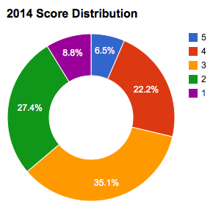
Preparing for the AP Biology Exam
Notes:
3 perfect scores, out of ~214,000 total exams worldwide

Slide 2
What do the scores mean? (According to the College Board)
AP exam score | Comparable freshman college course grade | How qualified are students to receive college credit or placement?
5 | A | Extremely well qualified
4 | A-, B+, B | Well qualified
3 | B-, C+, C | Qualified
2 |  | Possibly qualified
1 |  | No recommendation
Check what scores different colleges require: www.collegeboard.org/ap/creditpolicy

Slide 3
What do I need to know?
AP Biology Curriculum (content topics)
APPLICATION of knowledge through practice:
Modeling to explain biological principles
Use of MATH to explain concepts
Making predictions (What will happen?)
Justification of phenomena (Why did it happen?)
Experimental design
Manipulating & interpreting data

Slide 4
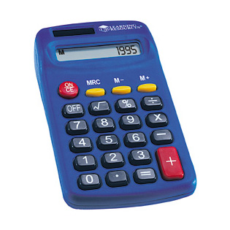
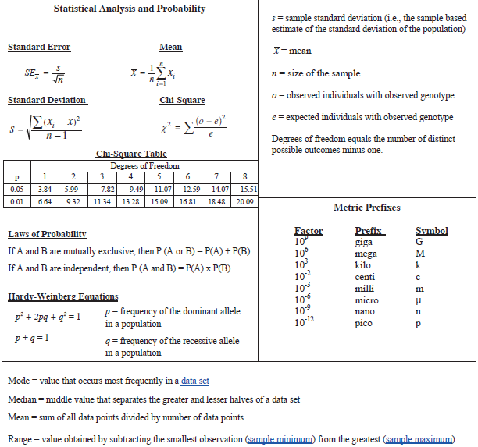
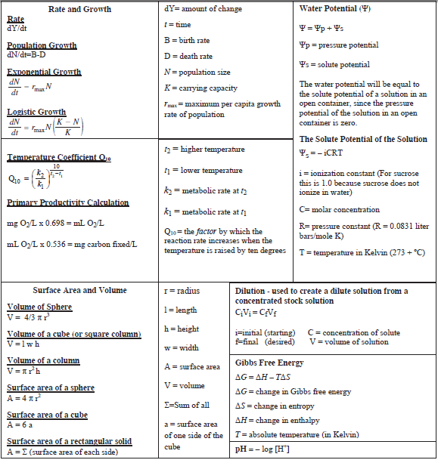
Did somebody say…MATH?
Use of a 4-function calculator
No graphing or scientific
No cell phones or iPods
Use of AP bio formula sheet
Mostly for Grid-in Questions

Slide 5
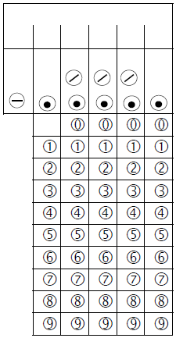
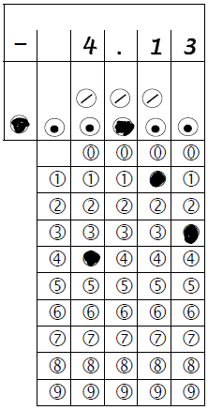
Test Format
Section One
Section Two
63 Multiple Choice
4 Choices (A, B, C, D)
No guessing penalty!
6 Grid-in (numeric ans.)
90 minutes to answer
2 “Long” Free Response (Essay)
6 “Short” Free Response (Short answer)
10 minute reading period (planning only)
80 minutes to answer

Slide 6
Test Scoring
Section One = 50%
63 Multiple Choice (1 pt ea) = approximately 45%
6 Grid-ins (1 point each) = approximately 5%
Section Two = 50%
2 Long Free Response (10 points each) = 25%
6 Short Free Response (3-4 points each) = 25%
Notes:
2014 exam: three 3-pt SFR & three 4-pt SFR

Slide 7
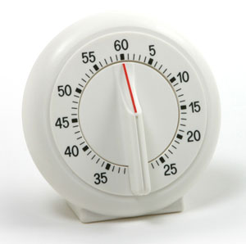
SUGGESTED Timing for Section One
TOTAL ALLOWED TIME = 90 minutes
80 minutes for Multiple Choice
63 multiple choice questions
Approximately 1.5 minutes per question
10 minutes for Grid-in Questions
6 grid-in questions
Approximately 2 minutes per question
Notes:
Suggested timing is proportional based on point distributions for different question types

Slide 8
Strategies for Multiple Choice
Read carefully—don’t simply skim!
Try to identify the concept(s) being tested
Determine what the question is asking
Remember that you’re looking for the BEST answer selection
There may be more than one correct choice
None of the choices might be the perfect answer
WRITE ON THE TEST!!!
Circle/underline key pieces of information
Cross out answer choices that you eliminate

Slide 9
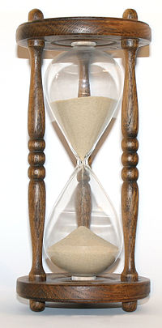
SUGGESTED Timing for Section Two
TOTAL ALLOWED TIME = 90 minutes
10 minute Reading Period (mandatory)
40 minutes on Long Free Response
2 Long Free Response questions
20 minutes per question
40 minutes on Short Free Response
6 Short Free Response questions
Approximately 6 minutes per question

Slide 10
Free Response ≠ English class Essay
Do NOT write a 5-paragraph essay!
Do NOT worry about correct grammar, spelling, or punctuation
Do NOT simply draw a diagram or chart
Do NOT worry about writing incorrect information
DO write legibly and in complete sentences
DO be sure to identify what the question is asking (essential words)
DO be specific
DO be careful not to contradict yourself
DO be sure to answer all parts of the question
Notes:
Essential words = describe, compare/contrast, identify, analyze, etc…

Slide 11
Experimental Design Questions
Design an experiment to answer a specific question posed about a scenario
Identify independent and dependent variables (use only ONE independent variable)
Describe both experimental and control treatments, identify constant variables
Discuss random sampling and testing in replicate (at least 3 test subjects or groups)
Describe and explain expected results (include a graph if appropriate)

Slide 12
How do I need to prepare?
Review all of the content (objective sheets)
Focus on areas of weakness (use the diagnostic tools on the website)
Explain and apply concepts, describe examples, design experiments
Make connections across different units
STUDY A LITTLE EVERY NIGHT!!!
Watch Bozeman (Final Review – 33 min.)
Get a 4-function calculator!
You will NOT be provided with one for the exam!
Notes:
Will not provide calculators for mock or actual exam!

Slide 13
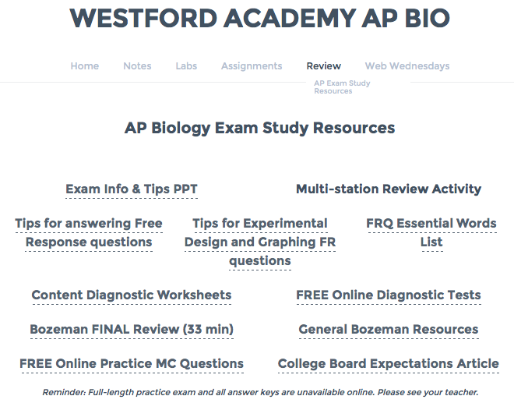
Website Review Resources

Slide 14
2015 Mock Exam
4 day exam: April 27th to May 1st
Day 1: 1 LFR & 3 SFR (5 RP* + 40 min)
Day 2: 1 LFR & 3 SFR (5 RP* + 40 min)
Day 3: 27 MC & 2 GI (40 min)
Day 4: 26 MC & 3 GI (40 min)
*Reading period: planning w/o answer booklet
Only 53 MC & 5 GI – The College Board did not release all of the 2014 test items

Slide 15
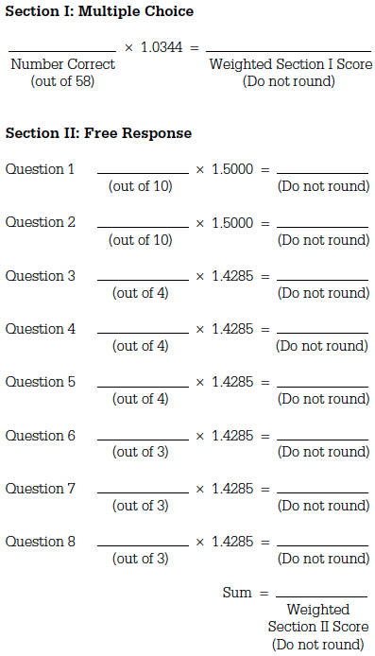
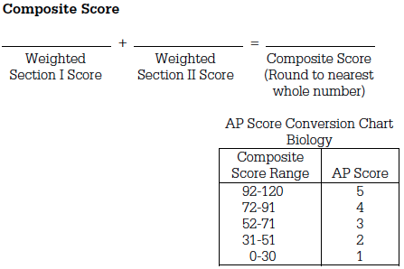
Mock Exam Scoring
4 3 2 1
100 95 85 75 65

Slide 16
What should I bring?
Don’t forget these items!
Leave these guys at home!
No. 2 pencils and erasers
Blue or black ink pens
4-function calculator
Government-issued ID
A well-rested brain
A well-fed stomach
Positive attitude
CONFIDENCE!
Cellphones
Tablets/laptops
Cameras
Watches that beep or have an alarm
Food/drink
BOTTLED WATER
ANY content-related material

Slide 17
After the Exam
Do not take any test materials out of the room
Do not discuss exam content
Social media (Twitter, Facebook, Instagram)
Texts, email, blogs, discussion boards
YOUR EXAM SCORE MAY BE CANCELLED AND YOU MAY BE BANNED FROM FUTURE AP EXAMS
2 days after the exam, you may discuss the free-response items IF they are posted on the College Board website
If you feel there was an issue during testing, notify WA’s AP Coordinators ASAP
Notes:
AP Coordinators = Brian Doherty &

